Slide 1
Airbnb Bangkok Analysis by Neighborhood
Ratu Balkis Khoirunnisa

Slide 2

Outline
Dataset Information
Audience
Topics
Data Visualization
Business Insight and Impact
Action Recommendation (for the audience)

Slide 3
Dataset Information
Sample Dataset
id | name | host_id | host_name | neighbourhood | latitude | longitude | room_type | price | minimum_nights | number_of_reviews | last_review | reviews_per_month | calculated_host_listings_count | availability_365 | number_of_reviews_ltm
27934 | Nice room with superb city view | 120437 | Nuttee | Ratchathewi | 1.375.983 | 10.054.134 | Entire home/apt | 1905 | 3 | 65 | 2020-01-06 | 0.5 | 2 | 353 | 0
27979 | Easy going landlord,easy place | 120541 | Emy | Bang Na | 1.366.818 | 10.061.674 | Private room | 1316 | 1 | 0 |  |  | 2 | 358 | 0
28745 | modern-style apartment in Bangkok | 123784 | Familyroom | Bang Kapi | 1.375.232 | 10.062.402 | Private room | 800 | 60 | 0 |  |  | 1 | 365 | 0
35780 | Spacious one bedroom at The Kris Condo Bldg. 3 | 153730 | Sirilak | Din Daeng | 1.378.823 | 10.057.256 | Private room | 1286 | 7 | 2 | 2022-04-01 | 0.03 | 1 | 323 | 1
941865 | Suite Room 3 at MetroPoint | 610315 | Kasem | Bang Kapi | 1.376.872 | 10.063.338 | Private room | 1905 | 1 | 0 |  |  | 3 | 365 | 0
1704776 | NEw Pro!! Bungalow Bkk Centre | 2129668 | Wimonpak | Bang Kho laen | 1.369.757 | 1.005.288 | Entire home/apt | 1000 | 250 | 19 | 2017-08-03 | 0.17 | 41 | 365 | 0
48736 | Condo with Chaopraya River View | 222005 | Athitaya | Rat Burana | 1.368.556 | 10.049.535 | Private room | 1558 | 3 | 1 | 2014-02-03 | 0.01 | 1 | 365 | 0
1738669 | 1 chic bedroom apartment in BKK | 7045870 | Jiraporn | Chatu Chak | 1.382.925 | 10.056.737 | Entire home/apt | 1461 | 1 | 0 |  |  | 1 | 365 | 0
1744248 | Batcave, Pool view, near Chatuchak | 9181769 | Nol | Chatu Chak | 1.381.693 | 10.056.433 | Entire home/apt | 1558 | 3 | 10 | 2016-03-29 | 0.09 | 1 | 365 | 0

Slide 4
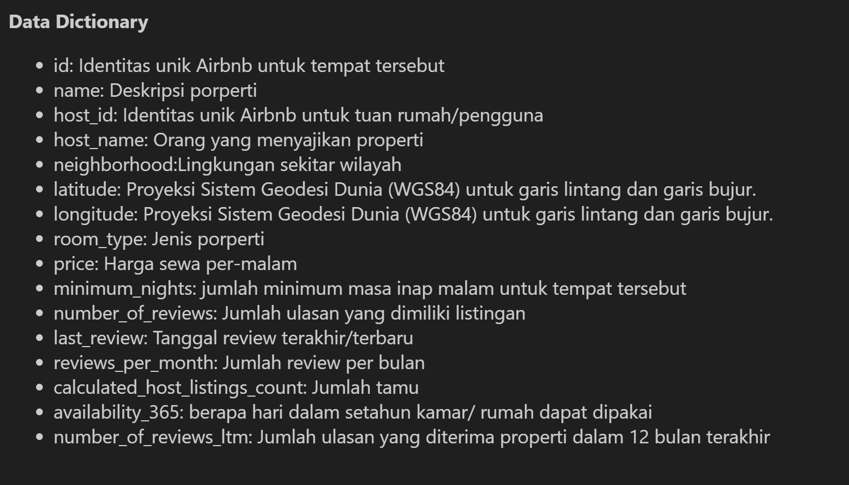
Data Dictionary

Slide 5


Audience
Marketing and Sales Team
Business Executive
Host/Owner listing

Slide 6
Topics
Average price analysis based on most popular vs least popular neighborhoods
Find out the factors of popular and least popular neighborhoods by looking at avg price
Analyze the most popular room types
Create business insight and impact for the audience based on the data that has been visualized
Make action recommendations for the audience based on business insight and impact

Slide 7
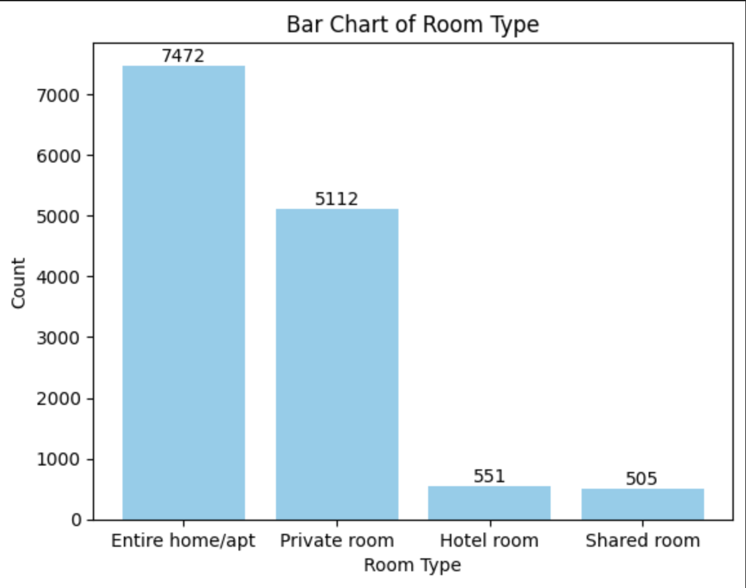
Visualization
Visualization Of The Number Of Room Types
The bar chart shows that hosts rent out more properties with room type Entire Home/Apt.

Slide 8
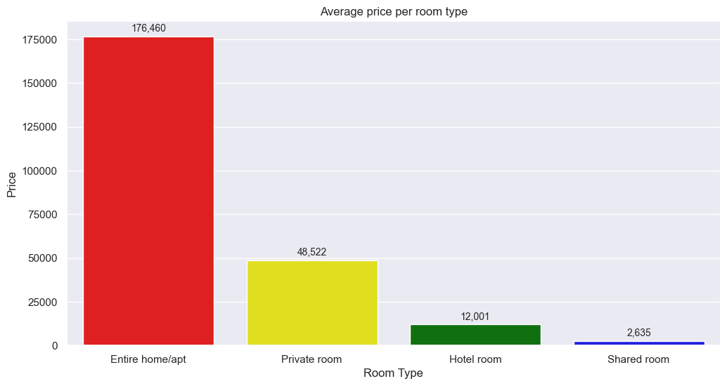
Visualization
Visualization Of Average Price In Every Room Type
Entire Home/Apt has the highest average price because more hosts rent out their property in the form of Entire Home/Apt.

Slide 9
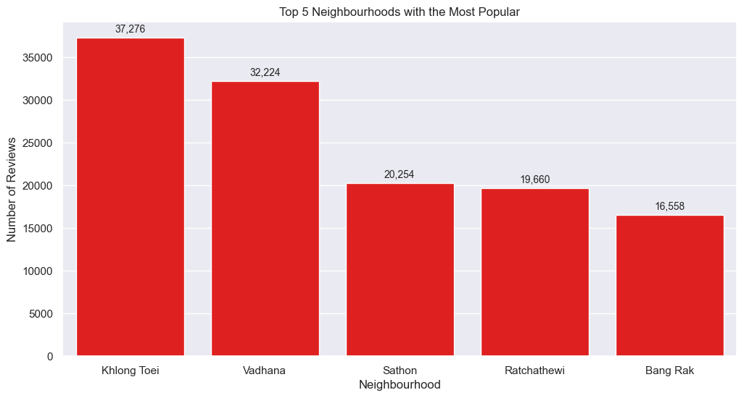
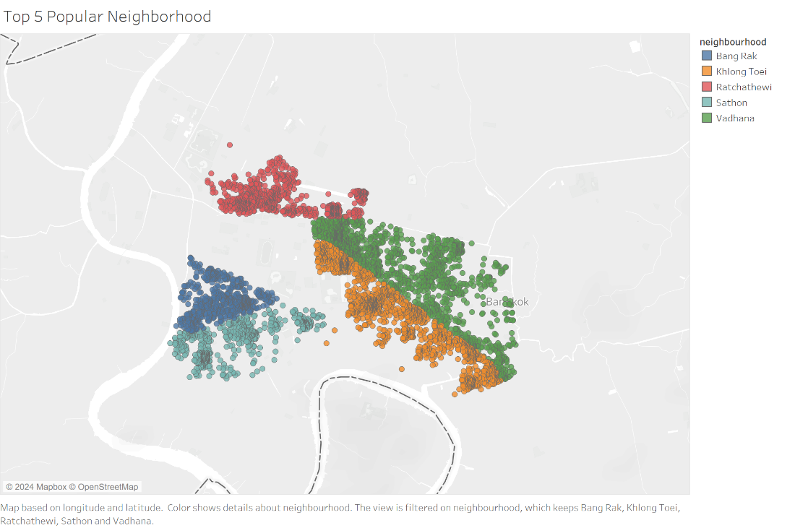
Visualization
Visualization Of Top 5 The Most Popular Neighborhood
From the visualization, it can be concluded that Khlong Toei is the most popular neighborhood because it is close to the city center and there are many large malls.
Central City

Slide 10
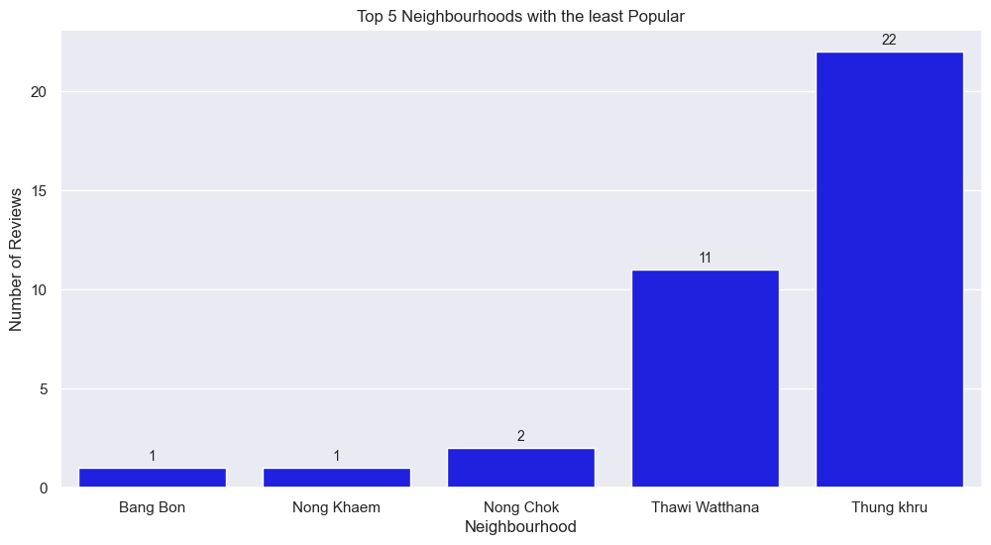
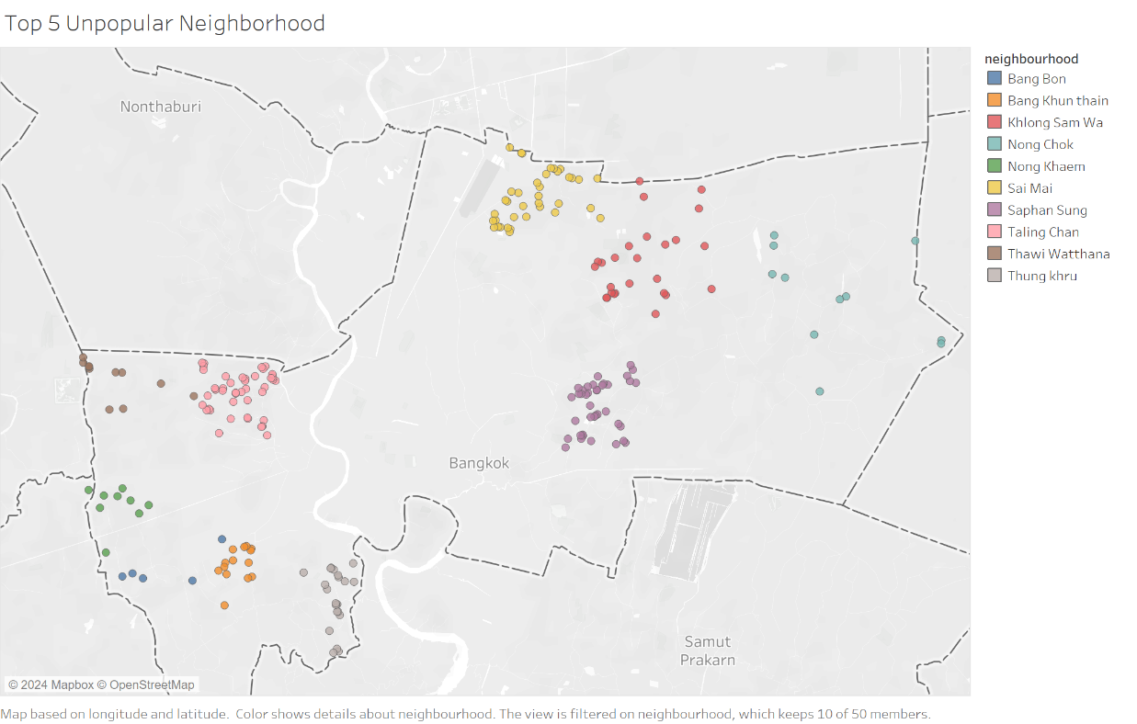
Visualization
Visualization Of Top 5 With The Least Popular Neighborhood
In contrast to the previous, the diagram below shows why this neighborhood is the least popular, because it is far from the city center.
Central City

Slide 11
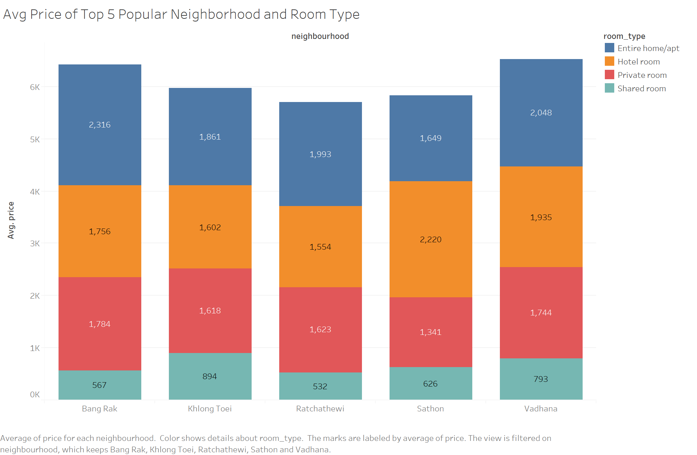
Visualization
Visualization Avg Price From Top 5 Popular Neighborhood and Room Type
From the diagram below it can be concluded that:
- Khlong Toei is most popular because the rent is cheaper than Vadhana which is not far from the city center.
- Sathon with the highest average hotel price among other neighborhoods, reaching 2000, because Sathon is a commercial and office area.

Slide 12
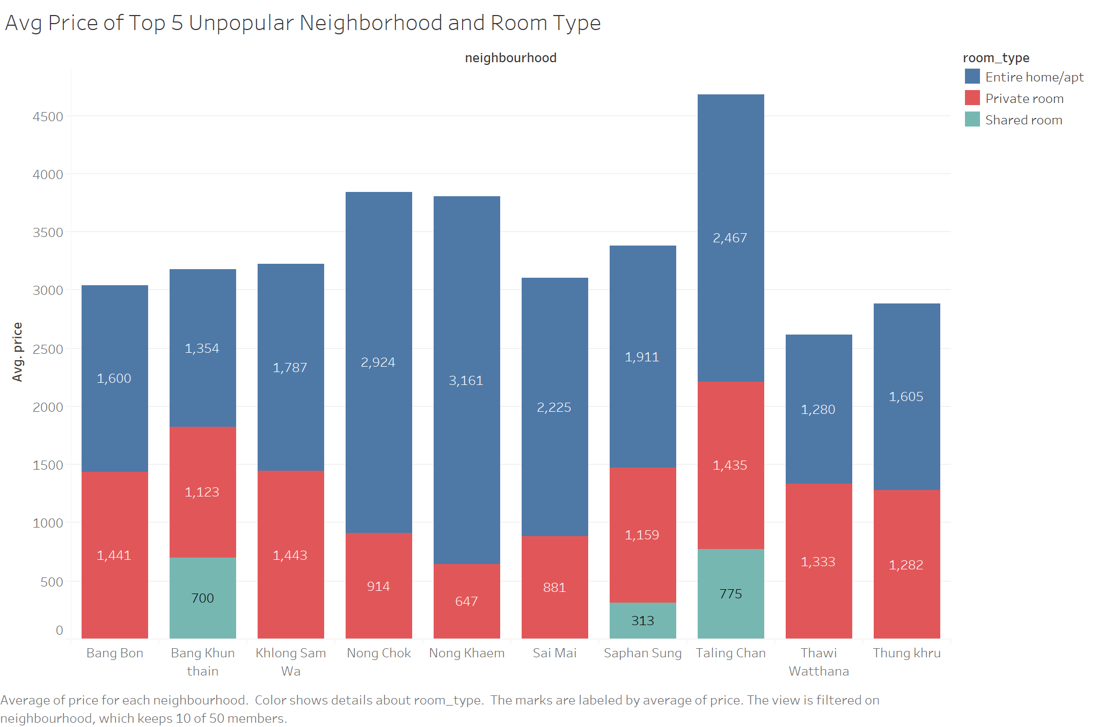
Visualization
Visualization Avg Price From Top 5 With The Least Popular Neighborhood and Room Type
From the diagram below it can be concluded that:
- Nong Khaem is the highest average price with room type Entire Home/Apt, this is the reason why Nong Khaem is the least popular neighborhood because the average price is high and it is far from the capital city and not too many tourist attractions can be visited.
- Bang Bon is not much different from Nong Khem although the average price is slightly lower than Nong Khem, not too many tourist attractions can be visited

Slide 13
Business Insight And Impaction
Insight:
Properties with "Entire home/apt" have significantly higher prices than "Private room.“ By realizing this price difference, owners can design exclusive packages and raise the price for a clear reason.
Host can set prices based on the value of a strategic location near the city center.
Business center as a competitive advantage.
Partnering with local businesses such as restaurants, cafes, or shopping centers
Setting more affordable prices or offering discounts given the distance from the city center.
Highlight the beauty and unique appeal of the neighborhood.
Provide a visual understanding of the attractiveness of the neighborhood.

Slide 14
Business Insight And Impaction
Impact:
host can design exclusive packages for "Entire home/apt" properties, such as: Daily room cleaning service, Access to additional facilities, Shuttle service from the airport to the inn/vehicle rental for increasing revenue per booking with clear reason.
Increasing the price with the benefit of easy access to the city center can optimize revenue and attract guests who value the convenience of the location.
Offering promotional packages or special discounts with local businesses can add value and provide a more complete experience for guests.
Affordable pricing is a strategy to attract guests who are looking for more affordable accommodation in the neighborhood.
Optimize online marketing with attractive visualizations such as photos or videos, helping potential guests feel the charm and uniqueness to want to stay overnight.
Enhanced online and offline marketing campaigns that highlighted the hotel's presence in the business center, attracting professionals looking for accommodation connected to business activities.

Slide 15
Action Recommendation (for the audience)
Marketing and Sales Team
Release video testimonials or blog posts from business executives who benefited from staying at the property during their business trip. Share their personal experiences through social media platforms and websites.
Provision of vouchers especially for hotels located around malls totaling 339.38 baths with a min. purchase of 1131.27 baths (min. purchase and discount can be adjusted according to the items to be sold) with merchants (ex: local brands that produce bags) that partner with the lodging
Business Executive
A personalized email campaign offering business executives an exclusive stay experience with additional amenities and VIP services tailored to their needs.
Online and offline marketing campaigns that highlight the property's advantages during major business events in the business center. Offer special amenities such as exclusive meeting rooms or premium catering services.
Host/Owner listing
Provide bundling to tourist attractions around the listing such as zoos, museums, etc.
Cooperate with local merchants to recommend guests to buy souvenirs or stop by cafes, eateries.
Organize additional facilities such as shuttle from public transportation places (airport, station, etc).
Free breakfast by adding cost to the rental price.
Provide lodging prices that are far from the city with prices that are slightly below the average price of lodging close to the city center.

Slide 16
Thank You

